Slide 1
Statistical Analysis of Attrition at Frito-Lay
Willis A. Jones
wajones@smu.edu
Notes:
Thank you all for the opportunity to share my analysis with you on attrition at Frito Lay. Really excited to share some details about my work and give you some insights that you could use to increase value within your company.

Slide 2
Question
What variables are most strongly associated with employee attrition at Frito-Lay?
Notes:
AS a reminder, here is the question you all asked me to help you answer

Slide 3
Data Used
Dataset consisted of 870 employees with 38 variables.
Software used for analysis: R & RStudio
Notes:
I answered that questions using the dataset you all provided on 870 employees. For each employee there were 38 variables made available to me.
I used R and R studio to answer you question presented and I feel that, using several data science tools, we were able to extract interesting insights from this data…..

Slide 4
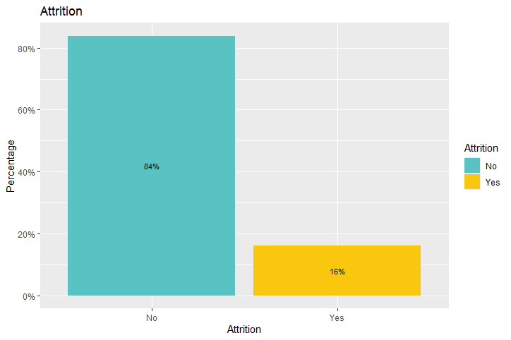
Notes:
First, lets look at overall attrition…about 16% of employees in this dataset left the company. According to some research I found, the average attrition rates for large companies is around 11%. So frito-ley seems to be a bit higher than the norm.

Slide 5
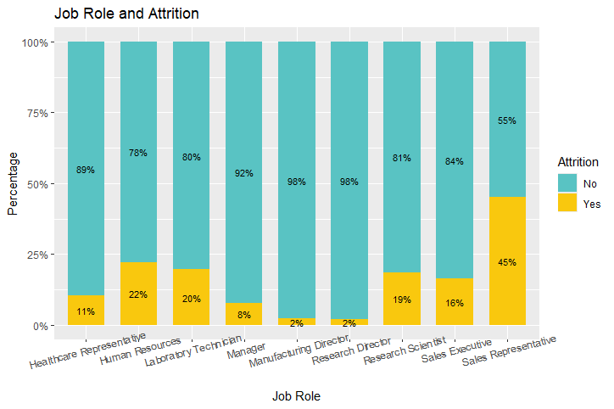
Notes:
You all asked specifically about attrition by job role. Here is a visualization of that relationship. As you can see, attrition is a big problem within sales were 45% of employees leave. Other areas with high levels of attrition are human resources, Lab technicians, and in the research department with directors and scientist.

Slide 6
Notes:
Shiny app

Slide 7
Data Analysis Process
Estimated the correlation between attrition and each employee variable in the dataset
Ranked the absolute value of correlation coefficients
Starting with the variables with the highest correlation with attrition, I added variables to a Naïve Bayes classifier with the goal of building a model with high sensitivity (>.60) and specificity (>.60)
Notes:
To conduct my analysis, I took the following steps….first I

Slide 8
Data Analysis Process
I used K-Fold (10 folds, 50 repetitions) Cross Validation to evaluate the predictive power of my Naïve Bayes model
Notes:
Finally, I used

Slide 9
Three variables with strongest correlation with attrition
Overtime (.27) Working overtime was correlated with higher levels of attrition
Marital Status (.19) Being single correlated with higher levels of attrition
Job Involvement (-.18) Higher levels of job involvement correlated with lower levels of attrition
Notes:
There were 3 variables with the strongest correlation with attrition. First, was overtime……
Divorced and married individuals were less likely to leave the company.
Just adding these three variables into a machine learning algorithm did not produce a high amount of predictive power….so to build a better classifier I needed to add move variable to my model.

Slide 10
Variables included in the Naïve Bayes algorithm
Variable Name | Correlation with Attrition
JobInvolvement | -0.1877934
TotalWorkingYears | -0.1672061
JobLevel | -0.1621364
YearsInCurrentRole | -0.1562157
MonthlyIncome | -0.1549150
Age | -0.1493836
StockOptionLevel | -0.1486803
YearsWithCurrManager | -0.1467822
YearsAtCompany | -0.1287541
JobSatisfaction | -0.1075209
Variable Name | Correlation with Attrition
OverTime | 0.2720366
MaritalStatus | 0.1970150
JobRole | 0.0905386
DistanceFromHome | 0.0871363
Department | 0.0870320
Notes:
These were the variables I added to the model. I essentially took the 15 variables with the highest correlation with Attrition and added them to the classification model.

Slide 11
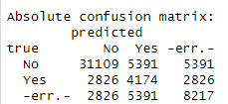
Results of Cross Validation
True positive rate (Sensitivity) = .85
True negative rate (Specificity) = .60
Notes:
The results of the cross validation are presented here with a confusion matrix…..Our model did a really good job of predicting those who did not leave the company…it was a little less successful in identifying those who did leave the company.
Overall, however, this classifier did a pretty good job of predicting who is at risk of leaving the company.

Slide 12
Conclusion
Using 15 parameters, we can identify individuals who are at high risk of leaving your company.
Three parameters in particular (marital status, overtime, and job involvement) had the strongest correlation with attrition.
Notes:
To conclude, using ………

Slide 13
Action Items
Consider limiting worker overtime, particularly in sales where attrition seems to be high.
Carefully monitor single employees and consider resources that can increase their retention.
Look for ways to increase the involvement of all employees as a retention strategy.
Target retention efforts at individuals within sales and research & development.
Notes:
Whatever value you get from a person working overtime might be offset by the cost of having to replace that person down the line.
When people feel invested in a company, they want to stay at that company

Slide 14
Thank You!
For additional information
Willis A. Jones
wajones@smu.edu
Notes:
Thank you very much.
If you would like further analysis of these data, we can certainly follow up with you.
Here is our contact information.
And we are happy to take any questions that you may have.

